Slide 1

Cryptography and Network Security
Seventh Edition
by William Stallings
Notes:
Lecture slides prepared for “Cryptography and Network Security”, 7/e, by William Stallings, Chapter 8 – “Random Bit Generation and Stream Ciphers”.

Slide 2
Chapter 8
Random Bit Generation and Stream Ciphers
Notes:
An important cryptographic function is the generation of random bit streams. Random
bits streams are used in a wide variety of contexts, including key generation and
encryption. In essence, there are two fundamentally different strategies for generating
random bits or random numbers. One strategy, which until recently dominated in cryptographic
applications, computes bits deterministically using an algorithm. This class of
random bit generators is known as pseudorandom number generators (PRNGs) or
deterministic random bit generators (DRBGs). The other strategy is to produce bits
non-deterministically using some physical source that produces some sort of random
output. This latter class of random bit generators is known as true random number
generators (TRNGs) or non-deterministic random bit generators (NRBGs).
The chapter begins with an analysis of the basic principles of PRNGs. Next, we
look at some common PRNGs, including PRNGs based on the use of a symmetric
block cipher. The chapter then moves on to the topic of symmetric stream ciphers,
which are based on the use of a PRNG. The chapter next examines the most important
stream cipher, RC4.
The remainder of the chapter is devoted to TRNGs. We look first at the basic
principles and structure of TRNGs, and then examine a specific product, the Intel
Digital Random Number Generator.
Throughout this chapter, reference is made to four important NIST documents:
■ SP 800-90A (Recommendation for Random Number Generation Using
Deterministic Random Bit Generators, January 2012) covers DRNGs.
■ SP 800-90B (Recommendation for the Entropy Sources Used for Random Bit
Generation, August 2012) covers criteria for entropy sources (ES), the devices
from which we get unpredictable randomness and NRNGs.
■ SP 800-90C (Recommendation for Random Bit Generator (RBG)
Constructions, August 2012) discusses how to combine the entropy sources in
90B with the DRNG’s from 90A to provide large quantities of unpredictable
bits for cryptographic applications.
■ SP 800-22 (A Statistical Test Suite for Random and Pseudorandom Number
Generators for Cryptographic Applications, April 2010) discusses the selection
and testing of NRBGs and DRBGs.
These specifications have heavily influenced the implementation of random bit
generators in industry both in the U.S. and worldwide.

Slide 3
Random Numbers
A number of network security algorithms and protocols based on cryptography make use of random binary numbers:
  Key distribution and reciprocal authentication schemes
  Session key generation
  Generation of keys for the RSA public-key encryption algorithm
  Generation of a bit stream for symmetric stream encryption
Notes:
A number of network security algorithms and protocols based on cryptography
make use of random binary numbers. For example,
• Key distribution and reciprocal (mutual) authentication schemes, such as
those discussed in Chapters 14 and 15. In such schemes, two communicating
parties cooperate by exchanging messages to distribute keys and/or authenticate
each other. In many cases, nonces are used for handshaking to prevent
replay attacks. The use of random numbers for the nonces frustrates an opponent’s
efforts to determine or guess the nonce, in order to repeat an obsolete
transaction.
• Session key generation. We will see a number of protocols in this book where
a secret key for symmetric encryption is generated for use for a particular
transaction (or session) and is valid for a short period of time. This key is
generally called a session key.
• Generation of keys for the RSA public-key encryption algorithm (described
in Chapter 9).
• Generation of a bit stream for symmetric stream encryption (described in this
chapter).
These applications give rise to two distinct and not necessarily compatible
requirements for a sequence of random numbers: randomness and unpredictability.

Slide 4
Randomness
The generation of a sequence of allegedly random numbers being random in some well-defined statistical sense has been a concern
Notes:
Traditionally, the concern in the generation of a sequence of allegedly
random numbers has been that the sequence of numbers be random in some
well-defined statistical sense. The following two criteria are used to validate that a
sequence of numbers is random:
• Uniform distribution: The distribution of bits in the sequence should be uniform;
that is, the frequency of occurrence of ones and zeros should be approximately
equal.
• Independence: No one subsequence in the sequence can be inferred from the
others.
Although there are well-defined tests for determining that a sequence of bits
matches a particular distribution, such as the uniform distribution, there is no such
test to “prove” independence. Rather, a number of tests can be applied to demonstrate
if a sequence does not exhibit independence. The general strategy is to apply
a number of such tests until the confidence that independence exists is sufficiently
strong. That is, if each of a number of tests fails to show that a sequence of bits is
not independent, then we can have a high level of confidence that the sequence is in
fact independent.

Slide 5
Unpredictability
The requirement is not just that the sequence of numbers be statistically random, but that the successive members of the sequence are unpredictable
With “true” random sequences each number is statistically independent of other numbers in the sequence and therefore unpredictable
  True random numbers have their limitations, such as inefficiency, so it is more common to implement algorithms that generate sequences of numbers that appear to be random
  Care must be taken that an opponent not be able to predict future elements of the sequence on the basis of earlier elements
Notes:
In applications such as reciprocal authentication, session key
generation, and stream ciphers, the requirement is not just that the sequence of
numbers be statistically random but that the successive members of the sequence
are unpredictable. With “true” random sequences, each number is statistically independent
of other numbers in the sequence and therefore unpredictable. Although
true random numbers are used in some applications, they have their limitations,
such as inefficiency, as is discussed shortly. Thus, it is more common to implement
algorithms that generate sequences of numbers that appear to be random. In this
latter case, care must be taken that an opponent not be able to predict future elements
of the sequence on the basis of earlier elements.

Slide 6
Pseudorandom Numbers
Cryptographic applications typically make use of algorithmic techniques for random number generation
These algorithms are deterministic and therefore produce sequences of numbers that are not statistically random
If the algorithm is good, the resulting sequences will pass many tests of randomness and are referred to as pseudorandom numbers
Notes:
Cryptographic applications typically make use of algorithmic techniques for random
number generation. These algorithms are deterministic and therefore produce
sequences of numbers that are not statistically random. However, if the algorithm is
good, the resulting sequences will pass many tests of randomness. Such numbers are
referred to as pseudorandom numbers .
You may be somewhat uneasy about the concept of using numbers generated
by a deterministic algorithm as if they were random numbers. Despite what might be
called philosophical objections to such a practice, it generally works. That is, under
most circumstances, pseudorandom numbers will perform as well as if they were
random for a given use. The phrase “as well as” is unfortunately subjective, but the
use of pseudorandom numbers is widely accepted. The same principle applies
in statistical applications, in which a statistician takes a sample of a population and
assumes that the results will be approximately the same as if the whole population
were measured

Slide 7
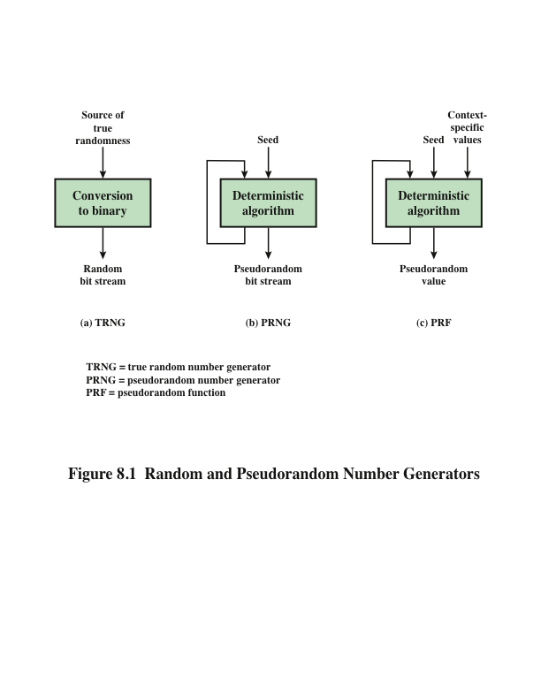
Notes:
Figure 8.1 contrasts a true random number generator (TRNG) with two forms
of pseudorandom number generators.

Slide 8
True Random Number Generator (TRNG)
Takes as input a source that is effectively random
The source is referred to as an entropy source and is drawn from the physical environment of the computer
  Includes things such as keystroke timing patterns, disk electrical activity, mouse movements, and instantaneous values of the system clock
  The source, or combination of sources, serve as input to an algorithm that produces random binary output
  The TRNG may simply involve conversion of an analog source to a binary output
  The TRNG may involve additional processing to overcome any bias in the source
Notes:
A TRNG takes as input a source that is effectively
random; the source is often referred to as an entropy source.
In essence, the entropy source is drawn from the physical
environment of the computer and could include things such as keystroke timing
patterns, disk electrical activity, mouse movements, and instantaneous values of the
system clock.
The source, or combination of sources, serve as input to an algorithm
that produces random binary output. The TRNG may simply involve conversion of
an analog source to a binary output. The TRNG may involve additional processing
to overcome any bias in the source; this is discussed in Section 8.6.

Slide 9
Pseudorandom Number Generator (PRNG)
Takes as input a fixed value, called the seed, and produces a sequence of output bits using a deterministic algorithm
  Quite often the seed is generated by a TRNG
The output bit stream is determined solely by the input value or values, so an adversary who knows the algorithm and the seed can reproduce the entire bit stream
    Other than the number of bits produced there is no difference between a PRNG and a PRF
Two different forms of PRNG
Notes:
In contrast, a PRNG takes as input a fixed value, called the seed , and produces
a sequence of output bits using a deterministic algorithm. Quite often, the seed is
generated by a TRNG. Typically, as shown, there is some feedback path by which
some of the results of the algorithm are fed back as input as additional output bits
are produced. The important thing to note is that the output bit stream is determined
solely by the input value or values, so that an adversary who knows the algorithm
and the seed can reproduce the entire bit stream.
Figure 8.1 shows two different forms of PRNGs, based on application.
• Pseudorandom number generator: An algorithm that is used to produce an
open-ended sequence of bits is referred to as a PRNG. A common application
for an open-ended sequence of bits is as input to a symmetric stream cipher, as
discussed in Section 8.4. Also, see Figure 4.1a.
• Pseudorandom function (PRF): A PRF is used to produced a pseudorandom
string of bits of some fixed length. Examples are symmetric encryption keys
and nonces. Typically, the PRF takes as input a seed plus some context specific
values, such as a user ID or an application ID. A number of examples of
PRFs will be seen throughout this book, notably in Chapters 17 and 18.
Other than the number of bits produced, there is no difference between a PRNG
and a PRF. The same algorithms can be used in both applications. Both require a seed
and both must exhibit randomness and unpredictability. Further, a PRNG application
may also employ context-specific input. In what follows, we make no distinction
between these two applications.

Slide 10

PRNG Requirements
The basic requirement when a PRNG or PRF is used for a cryptographic application is that an adversary who does not know the seed is unable to determine the pseudorandom string
The requirement for secrecy of the output of a PRNG or PRF leads to specific requirements in the areas of:
  Randomness
  Unpredictability
  Characteristics of the seed
Notes:
When a PRNG or PRF is used for a cryptographic application, then the basic
requirement is that an adversary who does not know the seed is unable to determine
the pseudorandom string. For example, if the pseudorandom bit stream is
used in a stream cipher, then knowledge of the pseudorandom bit stream would
enable the adversary to recover the plaintext from the ciphertext. Similarly, we
wish to protect the output value of a PRF. In this latter case, consider the following
scenario. A 128-bit seed, together with some context-specific values, are used
to generate a 128-bit secret key that is subsequently used for symmetric encryption.
Under normal circumstances, a 128-bit key is safe from a brute-force attack.
However, if the PRF does not generate effectively random 128-bit output values,
it may be possible for an adversary to narrow the possibilities and successfully use
a brute force attack.
This general requirement for secrecy of the output of a PRNG or PRF leads to
specific requirements in the areas of randomness, unpredictability, and the characteristics
of the seed. We now look at these in turn.

Slide 11

Randomness
The generated bit stream needs to appear random even though it is deterministic
There is no single test that can determine if a PRNG generates numbers that have the characteristic of randomness
  If the PRNG exhibits randomness on the basis of multiple tests, then it can be assumed to satisfy the randomness requirement
NIST SP 800-22 specifies that the tests should seek to establish three characteristics:
  Uniformity
  Scalability
  Consistency
Notes:
In terms of randomness, the requirement for a PRNG is that the generated
bit stream appear random even though it is deterministic. There is no single
test that can determine if a PRNG generates numbers that have the characteristic
of randomness. The best that can be done is to apply a sequence of tests to the
PRNG. If the PRNG exhibits randomness on the basis of multiple tests, then it can
be assumed to satisfy the randomness requirement. NIST SP 800-22
specifies that the tests should seek to establish the following three
characteristics.
• Uniformity: At any point in the generation of a sequence of random or pseudorandom
bits, the occurrence of a zero or one is equally likely, i.e., the probability
of each is exactly 1/2. The expected number of zeros (or ones) is n /2,
where n = the sequence length.
• Scalability: Any test applicable to a sequence can also be applied to subsequences
extracted at random. If a sequence is random, then any such extracted
subsequence should also be random. Hence, any extracted subsequence
should pass any test for randomness.
• Consistency: The behavior of a generator must be consistent across starting
values (seeds). It is inadequate to test a PRNG based on the output from a
single seed or an TRNG on the basis of an output produced from a single
physical output.

Slide 12
Randomness Tests
SP 800-22 lists 15 separate tests of randomness
Notes:
SP 800-22 lists 15 separate tests of randomness. An understanding of these
tests requires a basic knowledge of statistical analysis, so we don’t attempt a
technical description here. Instead, to give some flavor for the tests, we list three of
the tests and the purpose of each test, as follows.
• Frequency test: This is the most basic test and must be included in any test
suite. The purpose of this test is to determine whether the number of ones and
zeros in a sequence is approximately the same as would be expected for a truly
random sequence.
• Runs test: The focus of this test is the total number of runs in the sequence,
where a run is an uninterrupted sequence of identical bits bounded before
and after with a bit of the opposite value. The purpose of the runs test is to
determine whether the number of runs of ones and zeros of various lengths is
as expected for a random sequence.
• Maurer’s universal statistical test: The focus of this test is the number of bits
between matching patterns (a measure that is related to the length of a compressed
sequence). The purpose of the test is to detect whether or not the
sequence can be significantly compressed without loss of information. A significantly
compressible sequence is considered to be non-random.

Slide 13
Unpredictability
A stream of pseudorandom numbers should exhibit two forms of unpredictability:
  Forward unpredictability
    If the seed is unknown, the next output bit in the sequence should be unpredictable in spite of any knowledge of previous bits in the sequence
  Backward unpredictability
    It should not be feasible to determine the seed from knowledge of any generated values
    No correlation between a seed and any value generated from that seed should be evident
    Each element of the sequence should appear to be the outcome of an independent random event whose probability is 1/2
The same set of tests for randomness also provides a test of unpredictability
  A random sequence will have no correlation with a fixed value (the seed)
Notes:
A stream of pseudorandom numbers should exhibit two forms
of unpredictability:
• Forward unpredictability : If the seed is unknown, the next output bit in the
sequence should be unpredictable in spite of any knowledge of previous bits in
the sequence.
• Backward unpredictability : It should also not be feasible to determine the
seed from knowledge of any generated values. No correlation between a seed
and any value generated from that seed should be evident; each element of the
sequence should appear to be the outcome of an independent random event
whose probability is 1/2.
The same set of tests for randomness also provide a test of unpredictability. If the
generated bit stream appears random, then it is not possible to predict some bit or bit
sequence from knowledge of any previous bits. Similarly, if the bit sequence appears
random, then there is no feasible way to deduce the seed based on the bit sequence.
That is, a random sequence will have no correlation with a fixed value (the seed).

Slide 14

Seed Requirements
The seed that serves as input to the PRNG must be secure and unpredictable
The seed itself must be a random or pseudorandom number
Typically the seed is generated by TRNG
Notes:
For cryptographic applications, the seed that serves as input to
the PRNG must be secure. Because the PRNG is a deterministic algorithm, if the
adversary can deduce the seed, then the output can also be determined. Therefore,
the seed must be unpredictable. In fact, the seed itself must be a random or pseudorandom
number.

Slide 15
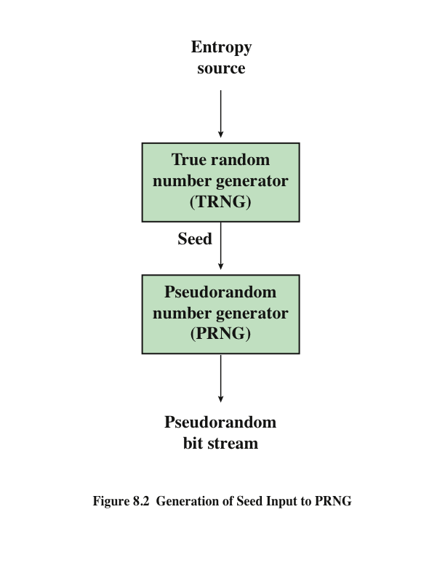
Notes:
Typically, the seed is generated by a TRNG, as shown in Figure 8.2. This is the
scheme recommended by SP800-90. The reader may wonder, if a TRNG is available,
why it is necessary to use a PRNG. If the application is a stream cipher, then
a TRNG is not practical. The sender would need to generate a keystream of bits as
long as the plaintext and then transmit the keystream and the ciphertext securely to
the receiver. If a PRNG is used, the sender need only find a way to deliver the stream
cipher key, which is typically 54 or 128 bits, to the receiver in a secure fashion.
Even in the case of a PRF application, in which only a limited number of bits
is generated, it is generally desirable to use a TRNG to provide the seed to the
PRF and use the PRF output rather than use the TRNG directly. As is explained
in Section 8.6, a TRNG may produce a binary string with some bias. The PRF
would have the effect of “randomizing” the output of the TRNG so as to eliminate
that bias.
Finally, the mechanism used to generate true random numbers may not be
able to generate bits at a rate sufficient to keep up with the application requiring
the random bits.

Slide 16
Algorithm Design
Algorithms fall into two categories:
  Purpose-built algorithms
    Algorithms designed specifically and solely for the purpose of generating pseudorandom bit streams
  Algorithms based on existing cryptographic algorithms
    Have the effect of randomizing input data
Notes:
Cryptographic PRNGs have been the subject of much research over the years,
and a wide variety of algorithms have been developed. These fall roughly into two
categories.
• Purpose-built algorithms: These are algorithms designed specifically and
solely for the purpose of generating pseudorandom bit streams. Some of these
algorithms are used for a variety of PRNG applications; several of these are
described in the next section. Others are designed specifically for use in a
stream cipher. The most important example of the latter is RC4, described in
Section 8.5.
• Algorithms based on existing cryptographic algorithms: Cryptographic algorithms
have the effect of randomizing input data. Indeed, this is a requirement
of such algorithms. For example, if a symmetric block cipher produced
ciphertext that had certain regular patterns in it, it would aid in the process of
cryptanalysis. Thus, cryptographic algorithms can serve as the core of PRNGs.
Three broad categories of cryptographic algorithms are commonly used to
create PRNGs:
—Symmetric block ciphers: This approach is discussed in Section 8.3.
—Asymmetric ciphers: The number theoretic concepts used for an asymmetric
cipher can also be adapted for a PRNG; this approach is examined in
Chapter 10.
—Hash functions and message authentication codes: This approach is examined
in Chapter 12.
Any of these approaches can yield a cryptographically strong PRNG.
A purpose-built algorithm may be provided by an operating system for general use.
For applications that already use certain cryptographic algorithms for encryption
or authentication, it makes sense to reuse the same code for the PRNG. Thus, all of
these approaches are in common use.

Slide 17
Linear Congruential Generator
An algorithm first proposed by Lehmer that is parameterized with four numbers:
m the modulus m > 0
a the multiplier 0 < a< m
c the increment 0≤ c < m
X₀ the starting value, or seed 0 ≤ X₀ < m
The sequence of random numbers {X_{n}} is obtained via the following iterative equation:
X_{n+1} = (aX_{n} + c) mod m
If m , a , c , and X₀ are integers, then this technique will produce a sequence of integers with each integer in the range 0 ≤ X_{n} < m
The selection of values for a , c , and m is critical in developing a good random number generator
Notes:
A widely used technique for pseudorandom number generation is an algorithm first
proposed by Lehmer [LEHM51], which is known as the linear congruential method.
The algorithm is parameterized with four numbers, as follows:
m the modulus m > 0
a the multiplier 0 < a< m
c the increment 0≤ c < m
X₀ the starting value, or seed 0 ≤ X₀ < m
The sequence of random numbers {X_{n}} is obtained via the following iterative equation:
X_{n+1} = (aX_{n} + c) mod m
If m , a , c , and X₀ are integers, then this technique will produce a sequence of integers
with each integer in the range 0 ≤ X_{n} < m .
The selection of values for a , c , and m is critical in developing a good random
number generator.
We would like m to be very large, so that there is the potential for producing
a long series of distinct random numbers. A common criterion is that m be nearly
equal to the maximum representable nonnegative integer for a given computer.
Thus, a value of m near to or equal to 231 is typically chosen.

Slide 18
Blum Blum Shub (BBS) Generator
Has perhaps the strongest public proof of its cryptographic strength of any purpose-built algorithm
Referred to as a cryptographically secure pseudorandom bit generator (CSPRBG)
  A CSPRBG is defined as one that passes the next-bit-test if there is not a polynomial-time algorithm that, on input of the first k bits of an output sequence, can predict the (k + 1)st bit with probability significantly greater than 1/2
The security of BBS is based on the difficulty of factoring n
Notes:
A popular approach to generating secure pseudorandom numbers is known as
the Blum, Blum, Shub (BBS) generator (see Figure 8.3), named for its developers.
It has perhaps the strongest public proof of its cryptographic strength
of any purpose-built algorithm.
The BBS is referred to as a cryptographically secure pseudorandom bit generator
(CSPRBG). A CSPRBG is defined as one that passes the next-bit test , which,
in turn, is defined as follows [MENE97]: A pseudorandom bit generator is said to
pass the next-bit test if there is not a polynomial-time algorithm that, on input of
the first k bits of an output sequence, can predict the (k + 1)st bit with probability
significantly greater than 1/2. In other words, given the first k bits of the sequence,
there is not a practical algorithm that can even allow you to state that the next bit
will be 1 (or 0) with probability greater than 1/2. For all practical purposes, the
sequence is unpredictable. The security of BBS is based on the difficulty of factoring n .
That is, given n , we need to determine its two prime factors p and q .

Slide 19
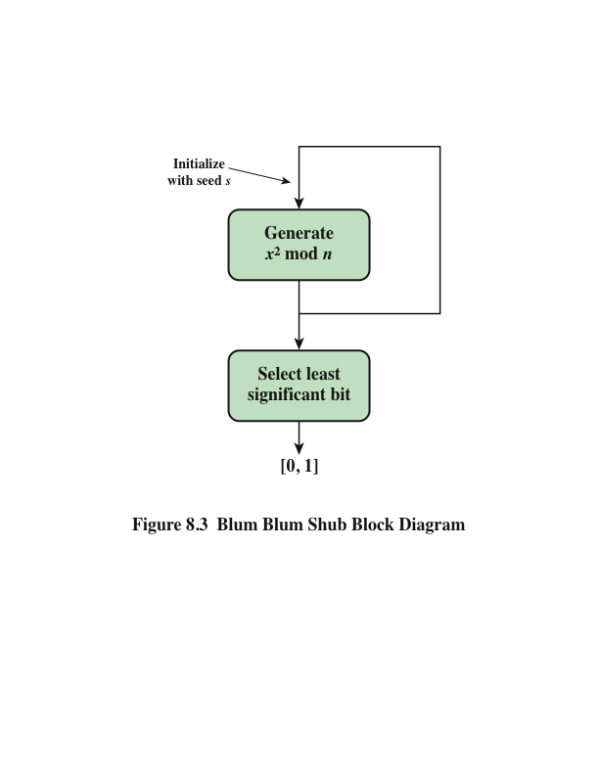
Notes:
A popular approach to generating secure pseudorandom numbers is known as
the Blum, Blum, Shub (BBS) generator (see Figure 8.3), named for its developers
[BLUM86].

Slide 20
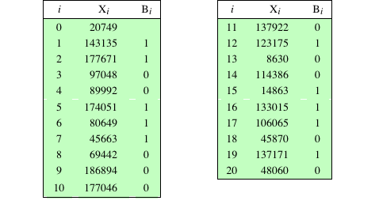
Table 8.1
Example Operation of BBS Generator
Notes:
Table 8.1, shows an example of BBS operation.

Slide 21
PRNG Using Block Cipher Modes of Operation
Two approaches that use a block cipher to build a PNRG have gained widespread acceptance:
  CTR mode
    Recommended in NIST SP 800-90, ANSI standard X.82, and RFC 4086
  OFB mode
    Recommended in X9.82 and RFC 4086
Notes:
Two approaches that use a block cipher to build a PNRG have gained widespread
acceptance: the CTR mode and the OFB mode. The CTR mode is recommended in
NIST SP 800-90, in the ANSI standard X9.82 (Random Number Generation ), and in
RFC 4086. The OFB mode is recommended in X9.82 and RFC 4086.

Slide 22
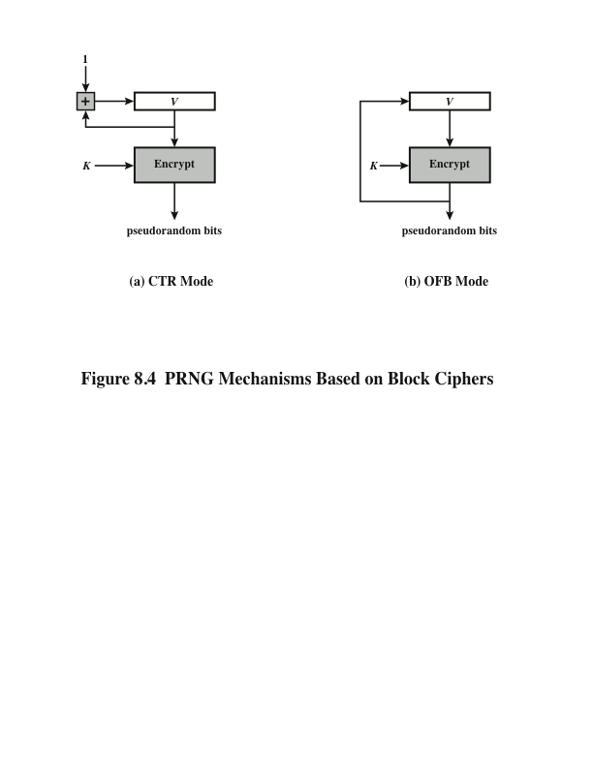
Notes:
Figure 8.4 illustrates the two methods. In each case, the seed consists of two
parts: the encryption key value and a value V that will be updated after each block
of pseudorandom numbers is generated. Thus, for AES-128, the seed consists of a
128-bit key and a 128-bit V value. In the CTR case, the value of V is incremented by 1
after each encryption. In the case of OFB, the value of V is updated to equal the
value of the preceding PRNG block. In both cases, pseudorandom bits are produced
one block at a time (e.g., for AES, PRNG bits are generated 128 bits at a time).

Slide 23
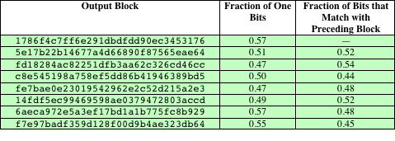
Table 8.2
Example Results for PRNG Using OFB
Notes:
For the OFB PRNG, Table 8.2 shows the first eight output blocks (1024 bits)
with two rough measures of security. The second column shows the fraction of one
bits in each 128-bit block. This corresponds to one of the NIST tests. The results
indicate that the output is split roughly equally between zero and one bits. The third
column shows the fraction of bits that match between adjacent blocks. If this number
differs substantially from 0.5, that suggests a correlation between blocks, which
could be a security weakness. The results suggest no correlation.

Slide 24
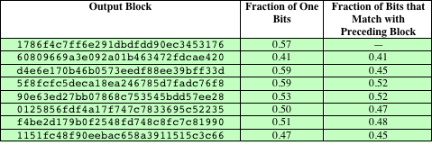
Table 8.3
Example Results for PRNG Using CTR
Notes:
Table 8.3 shows the results using the same key and V values for CTR mode.
Again, the results are favorable.

Slide 25
ANSI X9.17 PRNG
One of the strongest PRNGs is specified in ANSI X9.17
  A number of applications employ this technique including financial security applications and PGP
The algorithm makes use of triple DES for encryption.
  Ingredients are:
Notes:
One of the strongest (cryptographically speaking) PRNGs is specified in ANSI
X9.17. A number of applications employ this technique, including financial security
applications and PGP (the latter described in Chapter 19).
Figure 8.5 illustrates the algorithm, which makes use of triple DES for encryption.
The ingredients are as follows.
• Input: Two pseudorandom inputs drive the generator. One is a 64-bit representation
of the current date and time, which is updated on each number
generation. The other is a 64-bit seed value; this is initialized to some arbitrary
value and is updated during the generation process.
• Keys: The generator makes use of three triple DES encryption modules. All
three make use of the same pair of 56-bit keys, which must be kept secret and
are used only for pseudorandom number generation.
• Output: The output consists of a 64-bit pseudorandom number and a 64-bit
seed value.

Slide 26
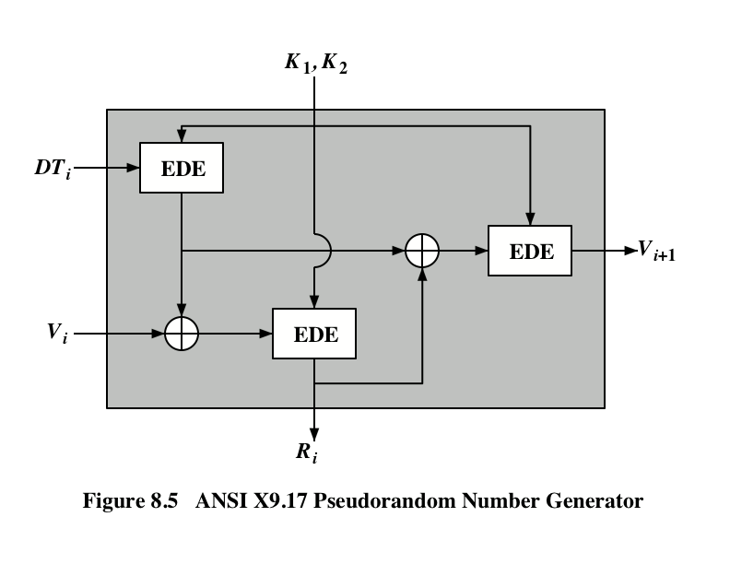
Notes:
Figure 8.5 illustrates the algorithm, which makes use of triple DES for encryption.

Slide 27
NIST CTR_DRBG
Counter mode-deterministic random bit generator
PRNG defined in NIST SP 800-90 based on the CTR mode of operation
Is widely implemented and is part of the hardware random number generator implemented on all recent Intel processor chips
DRBG assumes that an entropy source is available to provide random bits
  Entropy is an information theoretic concept that measures unpredictability or randomness
The encryption algorithm used in the DRBG may be 3DES with three keys or AES with a key size of 128, 192, or 256 bits
Notes:
We now look more closely at the details of the PRNG defined in NIST SP 800-90
based on the CTR mode of operation. The PRNG is referred to as CTR_DRBG
(counter mode–deterministic random bit generator). CTR_DRBG is widely implemented
and is part of the hardware random number generator implemented on all
recent Intel processor chips (discussed in Section 8.6).
The DRBG assumes that an entropy source is available to provide random
bits. Typically, the entropy source will be a TRNG based on some physical source.
Other sources are possible if they meet the required entropy measure of the application.
Entropy is an information theoretic concept that measures unpredictability,
or randomness; see Appendix F for details. The encryption algorithm used in the
DRBG may be 3DES with three keys or AES with a key size of 128, 192, or 256 bits.

Slide 28
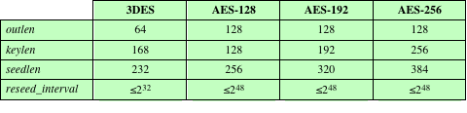
Table 8.4
CTR_DRBG Parameters
Notes:
Four parameters are associated with the algorithm:
• Output block length (outlen ): Length of the output block of the encryption
algorithm.
• Key length (keylen ): Length of the encryption key.
• Seed length (seedlen ): The seed is a string of bits that is used as input to a
DRBG mechanism. The seed will determine a portion of the internal state of
the DRBG, and its entropy must be sufficient to support the security strength
of the DRBG. seedlen = outlen + keylen .
• Reseed interval (reseed_interval ): Length of the encryption key. It is the maximum
number of output blocks generated before updating the algorithm with a
new seed.
Table 8.4 lists the values specified in SP 800-90 for these parameters.

Slide 29

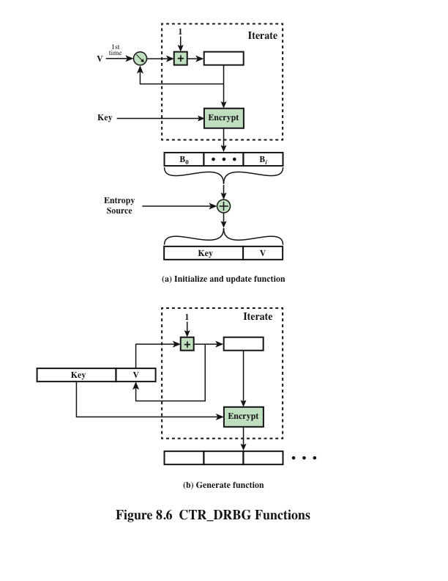
CTR_DRBG
Functions
Notes:
Figure 8.6 shows the two principal functions that comprise CTR_DRBG.
We first consider how CTR_DRBG is initialized, using the initialize and update
function (Figure 8.6a). Recall that the CTR block cipher mode requires both an
encryption key K and an initial counter value, referred to in SP 800-90 as the counter
V . The combination of K and V is referred to as the seed . To start the DRGB
operation, initial values for K and V are needed, and can be chosen arbitrarily. As
an example, the Intel Digital Random Number Generator, discussed in Section 7.6,
uses the values K = 0 and V = 0. These values are used as parameters for the CTR
mode of operation to produce at least seedlen bits. In addition, exactly seedlen bits
must be supplied from what is referred to as an entropy source . Typically, the entropy
source would be some form of TRNG.
With these inputs, the CTR mode of encryption is iterated to produce a
Sequence of output blocks, with V incremented by 1 after each encryption. The process
continues until at least seedlen bits have been generated. The leftmost seedlen
bits of output are then XORed with the seedlen entropy bits to produce a new seed.
In turn, the leftmost keylen bits of the seed form the new key and the rightmost
outlen bits of the seed form the new counter value V .
Once values of Key and V are obtained, the DRBG enters the generate
phase and is able to generate pseudorandom bits, one output block at a time
(Figure 7.6b). The encryption function is iterated to generate the number of pseudorandom
bits desired. Each iteration uses the same encryption key. The counter
value V is incremented by 1 for each iteration.
To enhance security, the number of bits generated by any PRNG should
be limited. CTR_DRGB uses the parameter reseed_interval to set that limit. During
the generate phase, a reseed counter is initialized to 1 and then incremented with
each iteration (each production of an output block). When the reseed counter
reaches reseed_interval , the update function is invoked (Figure 8.6a). The update
function is the same as the initialize function. In the update case the Key and V values
last used by the generate function serve as the input parameters to the update
function. The update function takes seedlen new bits from an entropy source and
produces a new seed (Key, V ). The generate function can then resume production
of pseudorandom bits. Note that the result of the update function is to change both
the Key and V values used by the generate function.

Slide 30
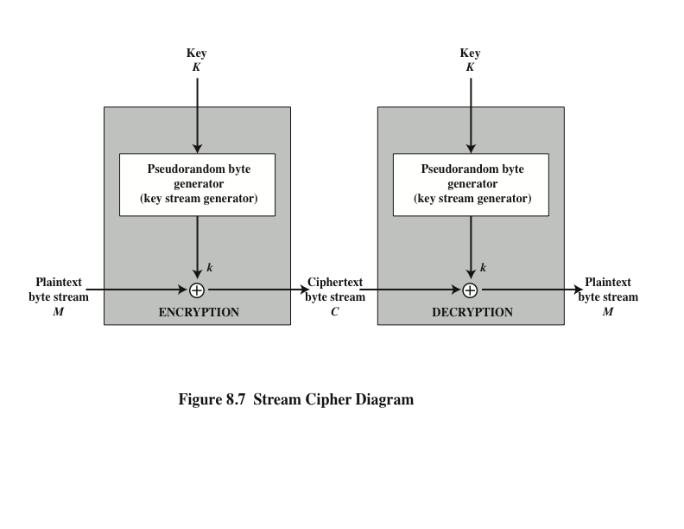
Notes:
A typical stream cipher encrypts plaintext one byte at a time, although a stream
cipher may be designed to operate on one bit at a time or on units larger than a byte
at a time. Figure 8.7 is a representative diagram of stream cipher structure. In this
structure, a key is input to a pseudorandom bit generator that produces a stream
of 8-bit numbers that are apparently random. The output of the generator, called
a keystream , is combined one byte at a time with the plaintext stream using the
bitwise exclusive-OR (XOR) operation.

Slide 31
Stream Cipher Design Considerations
Notes:
The stream cipher is similar to the one-time pad discussed in Chapter 3. The
difference is that a one-time pad uses a genuine random number stream, whereas a
stream cipher uses a pseudorandom number stream.
[KUMA97] lists the following important design considerations for a stream cipher.
1. The encryption sequence should have a large period. A pseudorandom number
generator uses a function that produces a deterministic stream of bits that
eventually repeats. The longer the period of repeat the more difficult it will
be to do cryptanalysis. This is essentially the same consideration that was discussed
with reference to the Vigenère cipher, namely that the longer the keyword
the more difficult the cryptanalysis.
2. The keystream should approximate the properties of a true random number
stream as close as possible. For example, there should be an approximately
equal number of 1s and 0s. If the keystream is treated as a stream of bytes,
then all of the 256 possible byte values should appear approximately equally
often. The more random-appearing the keystream is, the more randomized the
ciphertext is, making cryptanalysis more difficult.
3. Note from Figure 8.7 that the output of the pseudorandom number generator
is conditioned on the value of the input key. To guard against brute-force
attacks, the key needs to be sufficiently long. The same considerations that
apply to block ciphers are valid here. Thus, with current technology, a key
length of at least 128 bits is desirable.
With a properly designed pseudorandom number generator, a stream cipher
can be as secure as a block cipher of comparable key length. A potential advantage
of a stream cipher is that stream ciphers that do not use block ciphers as a building
block are typically faster and use far less code than do block ciphers. The example
in this chapter, RC4, can be implemented in just a few lines of code. In recent years,
this advantage has diminished with the introduction of AES, which is quite efficient
in software. Furthermore, hardware acceleration techniques are now available for
AES. For example, the Intel AES Instruction Set has machine instructions for one
round of encryption and decryption and key generation. Using the hardware instructions
results in speedups of about an order of magnitude compared to pure
software implementations [XU10].
One advantage of a block cipher is that you can reuse keys. In contrast, if two
plaintexts are encrypted with the same key using a stream cipher, then cryptanalysis
is often quite simple [DAWS96]. If the two ciphertext streams are XORed together,
the result is the XOR of the original plaintexts. If the plaintexts are text strings,
credit card numbers, or other byte streams with known properties, then cryptanalysis
may be successful.
For applications that require encryption/decryption of a stream of data, such as
over a data communications channel or a browser/Web link, a stream cipher might
be the better alternative. For applications that deal with blocks of data, such as file
transfer, e-mail, and database, block ciphers may be more appropriate. However,
either type of cipher can be used in virtually any application.
A stream cipher can be constructed with any cryptographically strong PRNG,
such as the ones discussed in Sections 8.2 and 8.3. In the next section, we look at a
stream cipher that uses a PRNG designed specifically for the stream cipher.

Slide 32
RC4
Designed in 1987 by Ron Rivest for RSA Security
Variable key size stream cipher with byte-oriented operations
Based on the use of a random permutation
Eight to sixteen machine operations are required per output byte and the cipher can be expected to run very quickly in software
Used in the Secure Sockets Layer/Transport Layer Security (SSL/TLS) standards that have been defined for communication between Web browsers and servers
Is also used in the Wired Equivalent Privacy (WEP) protocol and the newer WiFi Protected Access (WPA) protocol that are part of the IEEE 802.11 wireless LAN standard
Notes:
RC4 is a stream cipher designed in 1987 by Ron Rivest for RSA Security. It is a variable
key size stream cipher with byte-oriented operations. The algorithm is based
on the use of a random permutation. Analysis shows that the period of the cipher
is overwhelmingly likely to be greater than 10¹⁰⁰ [ROBS95a]. Eight to sixteen machine
operations are required per output byte, and the cipher can be expected to
run very quickly in software. RC4 is used in the Secure Sockets Layer/Transport
Layer Security (SSL/TLS) standards that have been defined for communication between
Web browsers and servers. It is also used in the Wired Equivalent Privacy
(WEP) protocol and the newer WiFi Protected Access (WPA) protocol that are
part of the IEEE 802.11 wireless LAN standard. RC4 was kept as a trade secret by
RSA Security. In September 1994, the RC4 algorithm was anonymously posted on
the Internet on the Cypherpunks anonymous remailers list.
The RC4 algorithm is remarkably simple and quite easy to explain. A variable-length
key of from 1 to 256 bytes (8 to 2048 bits) is used to initialize a 256-byte state
vector S, with elements S[0], S[1], c , S[255]. At all times, S contains a permutation
of all 8-bit numbers from 0 through 255. For encryption and decryption, a byte k (see
Figure 8.7) is generated from S by selecting one of the 255 entries in a systematic
fashion. As each value of k is generated, the entries in S are once again permuted.

Slide 33
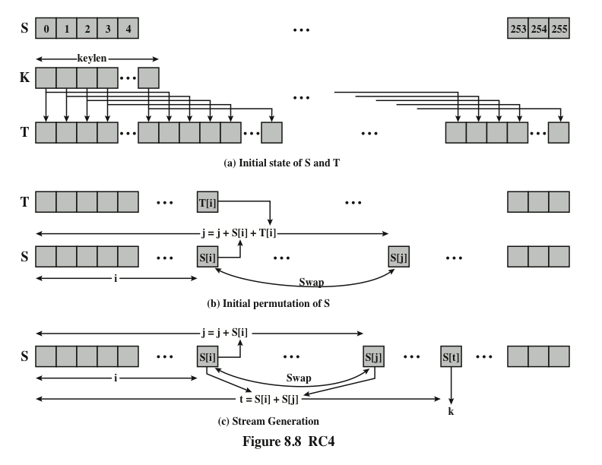
Notes:
Figure 8.8 illustrates the RC4 logic.

Slide 34
Strength of RC4
Notes:
A number of papers have been published analyzing methods of attacking RC4
(e.g., [KNUD98], [FLUH00], [MANT01]). None of these approaches is practical
against RC4 with a reasonable key length, such as 128 bits. A more serious problem
is reported in [FLUH01]. The authors demonstrate that the WEP protocol,
intended to provide confidentiality on 802.11 wireless LAN networks, is vulnerable
to a particular attack approach. In essence, the problem is not with RC4 itself
but the way in which keys are generated for use as input to RC4. This particular
problem does not appear to be relevant to other applications using RC4 and can be
remedied in WEP by changing the way in which keys are generated. This problem
points out the difficulty in designing a secure system that involves both cryptographic
functions and protocols that make use of them.

Slide 35
Entropy Sources
A true random number generator (TRNG) uses a nondeterministic source to produce randomness
Most operate by measuring unpredictable natural processes such as pulse detectors of ionizing radiation events, gas discharge tubes, and leaky capacitors
Intel has developed a commercially available chip that samples thermal noise by amplifying the voltage measured across undriven resistors
LavaRnd is an open source project for creating truly random numbers using inexpensive cameras, open source code, and inexpensive hardware
  The system uses a saturated CCD in a light-tight can as a chaotic source to produce the seed; software processes the result into truly random numbers in a variety of formats
Notes:
A true random number generator (TRNG) uses a nondeterministic source to
produce randomness. Most operate by measuring unpredictable natural processes,
such as pulse detectors of ionizing radiation events, gas discharge tubes,
and leaky capacitors. Intel has developed a commercially available chip that samples
thermal noise by amplifying the voltage measured across undriven resistors
[JUN99]. LavaRnd is an open source project for creating truly random numbers
using inexpensive cameras, open source code, and inexpensive hardware. The
system uses a saturated CCD in a light-tight can as a chaotic source to produce
the seed. Software processes the result into truly random numbers in a variety of
formats.

Slide 36
Possible Sources of Randomness
RFC 4086 lists the following possible sources of randomness that can be used on a computer to generate true random sequences:
  There is also an online service (random.org) which can deliver random sequences securely over the Internet
Notes:
RFC 4086 lists the following possible sources of randomness that, with care,
easily can be used on a computer to generate true random sequences.
• Sound/video input: Many computers are built with inputs that digitize some
real-world analog source, such as sound from a microphone or video input
from a camera. The “input” from a sound digitizer with no source plugged
in or from a camera with the lens cap on is essentially thermal noise. If the
system has enough gain to detect anything, such input can provide reasonably
high quality random bits.
• Disk drives: Disk drives have small random fluctuations in their rotational
speed due to chaotic air turbulence [JAKO98]. The addition of low-level disk
seek-time instrumentation produces a series of measurements that contain
this randomness. Such data is usually highly correlated, so significant processing
is needed. Nevertheless, experimentation a decade ago showed that, with
such processing, even slow disk drives on the slower computers of that day
could easily produce 100 bits a minute or more of excellent random data.
There is also an online service (random.org), which can deliver random
sequences securely over the Internet.

Slide 37
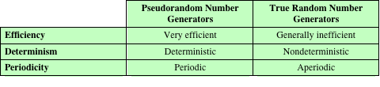
Table 8.5
Comparison of PRNGs and TRNGs
Notes:
Table 8.5 summarizes the principal differences between PRNGs and TRNGs.
PRNGs are efficient, meaning they can produce many numbers in a short time, and
deterministic, meaning that a given sequence of numbers can be reproduced at a
later date if the starting point in the sequence is known. Efficiency is a nice characteristic
if your application needs many numbers, and determinism is handy if you
need to replay the same sequence of numbers again at a later stage. PRNGs are
typically also periodic, which means that the sequence will eventually repeat itself.
While periodicity is hardly ever a desirable characteristic, modern PRNGs have a
period that is so long that it can be ignored for most practical purposes.
TRNGs are generally rather inefficient compared to PRNGs, taking considerably
longer time to produce numbers. This presents a difficulty in many applications.
For example, cryptography system in banking or national security might need
to generate millions of random bits per second. TRNGs are also nondeterministic,
meaning that a given sequence of numbers cannot be reproduced, although the same
sequence may of course occur several times by chance. TRNGs have no period.

Slide 38
Conditioning
A TRNG may produce an output that is biased in some way (such as having more ones than zeros or vice versa)
Biased
  NIST SP 800-90B defines a random process as biased with respect to an assumed discrete set of potential outcomes if some of those outcomes have a greater probability of occurring than do others
  Entropy rate
  NIST 800-90B defines entropy rate as the rate at which a digitized noise source provides entropy
  Is a measure of the randomness or unpredictability of a bit string
  Will be a value between 0 (no entropy) and 1 (full entropy)
  Conditioning algorithms/deskewing algorithms
  Methods of modifying a bit stream to further randomize the bits
  Typically conditioning is done by using a cryptographic algorithm to scramble the random bits so as to eliminate bias and increase entropy
  The two most common approaches are the use of a hash function or a symmetric block cipher
Notes:
A TRNG may produce an output that is biased in some way, such as having more
ones than zeros or vice versa. More generally, NIST SP 800-90B defines a random
process as biased with respect to an assumed discrete set of potential outcomes
(i.e., possible output values) if some of those outcomes have a greater probability
of occurring than do others. For example, a physical source such as electronic noise
may contain a superposition of regular structures, such as waves or other periodic
phenomena, which may appear to be random, yet are determined to be non-random
using statistical tests.
In addition to bias, another concept used by SP 800-98B is that of entropy rate .
SP 800-90B defines entropy rate as the rate at which a digitized noise source (or
entropy source) provides entropy; it is computed as the assessed amount of entropy
provided by a bit string output from the source, divided by the total number of
bits in the bit string (yielding assessed bits of entropy per output bit). This will be
a value between 0 (no entropy) and 1 (full entropy). Entropy rate is a measure
of the randomness or unpredictability of a bit string. Another way of expressing
it is that the entropy rate is k /n for a random source of length n bits and min-entropy
k . Min-entropy is a measure of the number of random bits and is explained
in Appendix F. In essence, a block of bits or a bit stream that is unbiased, and in
which each bit and each group of bits is independent of all other bits and groups of
bits will have an entropy rate of 1.
For hardware sources of random bits, the recommended approach is to assume
that there may be bias and/or an entropy rate of less than 1 and to apply techniques
to further “randomize” the bits. Various methods of modifying a bit stream for this
purpose have been developed. These are referred to as conditioning algorithms or
deskewing algorithms .
Typically, conditioning is done by using a cryptographic algorithm to “scramble”
the random bits so as to eliminate bias and increase entropy. The two most common
approaches are the use of a hash function or a symmetric block cipher.

Slide 39
Hash Function
A hash function produces an n-bit output from an input of arbitrary length
A simple way to use a hash function for conditioning is as follows:
  Blocks of m input bits, with m ≥ n, are passed through the hash function and the n output bits are used as random bits
  To generate a stream of random bits, successive input blocks pass through the hash function to produce successive hashed output blocks
Notes:
A hash function produces an n -bit output
from an input of arbitrary length. A simple way to use a hash function for conditioning
is as follows. Blocks of m input bits, with m Ú n , are passed through the
hash function and the n output bits are used as random bits. To generate a stream
of random bits, successive input blocks pass through the hash function to produce
successive hashed output blocks.
Operating systems typically provide a built-in mechanism for generating random
numbers. For example, Linux uses four entropy sources: mouse and keyboard
activity, disk I/O operations, and specific interrupts. Bits are generated from these
four sources and combined in a pooled buffer. When random bits are needed, the
appropriate number of bits are read from the buffer and passed through the SHA-1
hash function [GUTT06].
A more complex approach is the hash derivation function specified in
SP800-90A. Hash_df can be defined as follows:
Parameters:
input_string : The string to be hashed.
outlen : Output length.
no_of_bits_to_return : The number of bits to be returned by Hash_df. The maximum
length (max_number_of_bits ) is implementation dependent, but shall be
less than or equal to (255 * outlen ). no_of_bits_to_return is represented as a
32-bit integer.
requested_bits : The result of performing the Hash_df.

Slide 40
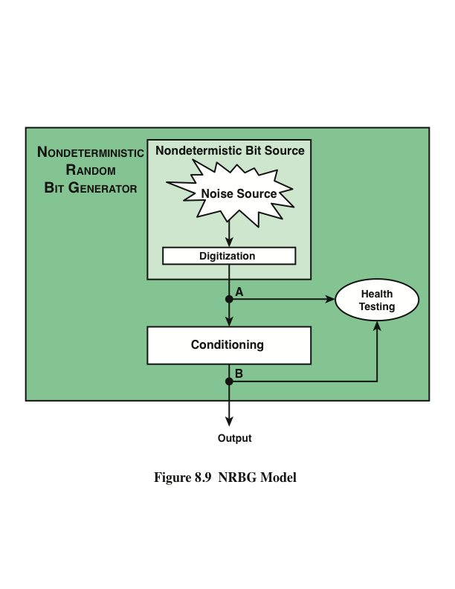
Notes:
Figure 8.9 provides a general model for a nondeterministic random bit generator.
A hardware noise source produces a true random output. This is digitized to produce
true, or nondeterministic, source of bits. This bit source then passes through a
conditioning module to mitigate bias and maximize entropy.
Figure 8.9 also shows a health-testing module, which is used on the outputs
of both the digitizer and conditioner. In essence, health testing is used to validate
that the noise source is working as expected and that the conditioning module is
produced output with the desired characteristics. Both forms of health testing are
recommended by SP 800-90B.

Slide 41
Health Tests on the Noise Source
The nature of the health testing of the noise source depends strongly on the technology used to produce noise
In general, the assumption can be made that the digitized output of the noise source will exhibit some bias
  Thus, traditional statistical tests are not useful for monitoring the noise source, because the noise source is likely to always fail
  The tests on the noise source need to be tailored to the expected statistical behavior of the correctly operating noise source
  The goal is not to determine if the source is unbiased, but if it is operating as expected
Notes:
The nature of the health testing of the noise
source depends strongly on the technology used to produce noise. In general, we
can assume that the digitized output of the noise source will exhibit some bias. Thus,
the traditional statistical tests, such as those defined in SP 800-22 and discussed in
Section 8.1, are not useful for monitoring the noise source, because the noise source
is likely to always fail. Rather, the tests on the noise source need to be tailored to
the expected statistical behavior of the correctly operating noise source. The goal
is not to determine if the source is unbiased, which it isn’t, but if it is operating
as expected.
SP 800-90B specifies that continuous tests be done on digitized samples
obtained from the noise source (point A in Figure 8.9). The purpose is to test for
variability. More specifically, the purpose is to determine if the noise source is producing
at the expected entropy rate. SP 800-909B mandates the use of two tests: the
Repetition Count Test and the Adaptive Proportion Test.
The Repetition Count Test is designed to quickly detect a catastrophic failure
that causes the noise source to become “stuck” on a single output value for a long
time. For this test, it is assumed that a given noise source is assessed to have a given
min-entropy value of H . The entropy is expressed as the amount of entropy
per sample, where a sample could be a single bit or some block of bits of length n . With an
assessed value of H , it is straightforward to calculate the probability that a sequence
of C consecutive samples will yield identical sample values.
The Repetition Count Test starts by recording a sample value and then counting
the number of repetitions of the same value. If the counter reaches the cutoff
value C, an error is reported. If a sample value is encountered that differs from the
preceding sample, then the counter is reset to 1 and the algorithm starts over.
The Adaptive Proportion Test is designed to detect a large loss of entropy,
such as might occur as a result of some physical failure or environmental change
affecting the noise source. The test continuously measures the local frequency of
occurrence of some sample value in a sequence of noise source samples to determine
if the sample occurs too frequently

Slide 42
Health Tests on the Noise Source
SP 800-90B specifies that continuous tests be done on digitized samples obtained from the noise source
  The purpose is to test for variability and to determine if the noise source is producing at the expected entropy rate
SP 800-90B mandates the use of two tests
  Repetition Count Test
    Designed to quickly detect a catastrophic failure that causes the noise source to become “stuck” on a single output value for a long time
    Involves looking for consecutive identical samples
  Adaptive Proportion Test
    Designed to detect a large loss of entropy, such as might occur as a result of some physical failure or environmental change affecting the noise source
    The test continuously measures the local frequency of occurrence of some sample value in a sequence of noise source samples to determine if the sample occurs too frequently
Notes:
SP 800-90B specifies that continuous tests be done on digitized samples
obtained from the noise source (point A in Figure 8.9). The purpose is to test for
variability. More specifically, the purpose is to determine if the noise source is producing
at the expected entropy rate. SP 800-909B mandates the use of two tests: the
Repetition Count Test and the Adaptive Proportion Test.
The Repetition Count Test is designed to quickly detect a catastrophic failure
that causes the noise source to become “stuck” on a single output value for a long
time. For this test, it is assumed that a given noise source is assessed to have a given
min-entropy value of H . The entropy is expressed as the amount of entropy
per sample, where a sample could be a single bit or some block of bits of length n . With an
assessed value of H , it is straightforward to calculate the probability that a sequence
of C consecutive samples will yield identical sample values.
The Repetition Count Test starts by recording a sample value and then counting
the number of repetitions of the same value. If the counter reaches the cutoff
value C, an error is reported. If a sample value is encountered that differs from the
preceding sample, then the counter is reset to 1 and the algorithm starts over.
The Adaptive Proportion Test is designed to detect a large loss of entropy,
such as might occur as a result of some physical failure or environmental change
affecting the noise source. The test continuously measures the local frequency of
occurrence of some sample value in a sequence of noise source samples to determine
if the sample occurs too frequently

Slide 43
Health Tests on the Conditioning Function
Notes:
SP 800-90B specifies that health tests should also be applied to the output of the conditioning component (point B in Figure 8.9), but does not indicate which tests to use. The purpose of the health
tests on the conditioning component is to assure that the output behaves as a true
random bit stream. Thus, it is reasonable to use the tests for randomness defined in
SP 800-22, and described in Section 8.1.

Slide 44
Intel Digital Random Number Generator
TRNGs have traditionally been used only for key generation and other applications where only a small number of random bits were required
  This is because TRNGs have generally been inefficient with a low bit rate of random bit production
The first commercially available TRNG that achieves bit production rates comparable with that of PRNGs is the Intel digital random number generator offered on new multicore chips since May 2012
  It is implemented entirely in hardware
  The entire DRNG is on the same multicore chip as the processors
Notes:
As was mentioned, TRNGs have traditionally been used only for key generation
and other applications where only a small number of random bits were required.
This is because TRNGs have generally been inefficient, with a low bit rate of random
bit production.
The first commercially available TRNG that achieves bit production rates
comparable with that of PRNGs is the Intel digital random number generator
(DRNG) [TAYL11], offered on new multicore chips since May 2012.
Two notable aspects of the DRNG:
1. It is implemented entirely in hardware. This provides greater security than a facility
that includes a software component. A hardware-only implementation should
also be able to achieve greater computation speed than a software module.
2. The entire DRNG is on the same multicore chip as the processors. This eliminates
the I/O delays found in other hardware random number generators.

Slide 45
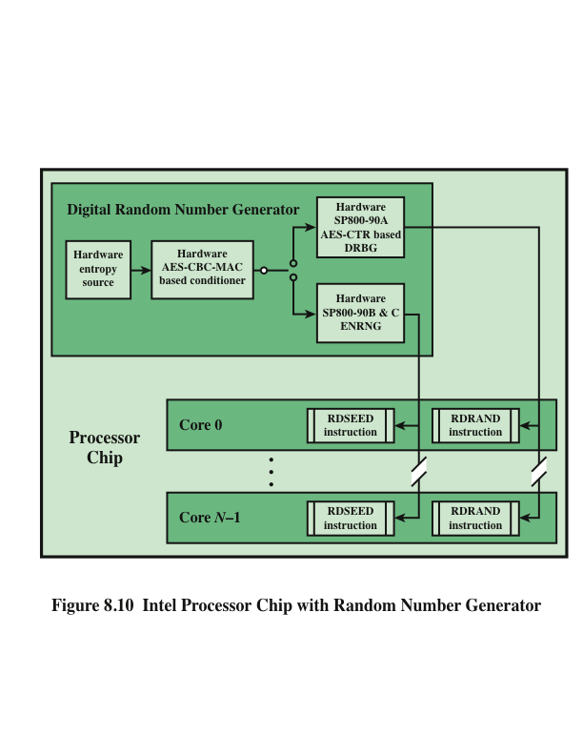
Notes:
Figure 8.10 shows the overall structure of the DRNG. The first stage of the DRNG
generates random numbers from thermal noise. The heart of the stage consists of
two inverters (NOT gates), with the output of each inverter connected to the input
of the other. Such an arrangement has two stable states, with one inverter having an
output of logical 1 and the other having an output of logical 0. The circuit is then configured
so that both inverters are forced to have the same indeterminate state (both
inputs and both outputs at logical 1) by clock pulses. Random thermal noise within
the inverters soon jostles the two inverters into a mutually stable state. Additional
circuitry is intended to compensate for any biases or correlations. This stage is
capable, with current hardware, of generating random bits at a rate of 4 Gbps.
The output of the first stage is generated 512 bits at a time. To assure that
the bit stream does not have skew or bias, a second stage of processing randomizes
its input using a cryptographic function. In this case, the function is referred to
as CBC-MAC or CMAC, as specified in NIST SP 800-38B. In essence, CMAC
encrypts its input using the cipher block chaining (CBC) mode (Figure 6.4) and
outputs the final block. We examine CMAC in detail in Chapter 12. The output of
this stage is generated 256 bits at a time and is intended to exhibit true randomness
with no skew or bias.
While the hardware’s circuitry generates random numbers from thermal noise
much more quickly than its predecessors, it’s still not fast enough for some of today’s
computing requirements. To enable the DRNG to generate random numbers
as quickly as software PRNG, and also maintain the high quality of the random numbers,
a third stage is added. This stage uses the 256-bit random numbers to seed
a cryptographically secure PRNG that creates 128-bit numbers. From one 256-bit
seed, the PRNG can output many pseudorandom numbers, exceeding the 3-Gbps
rate of the entropy source. An upper bound of 511 128-bit samples can be generated
per seed. The algorithm used for this stage is CTR_DRBG, described in Section 8.3.
The output of the DRNG is available to each of the cores on the chip via the
RDRAND instruction. RDRAND retrieves a 16-, 32-, or 64-bit random value and
makes it available in a software-accessible register.
Preliminary data from a pre-production sample on a system with a third
generation Intel® Core™ family processor produced the following performance
[INTE12]: up to 70 million RDRAND invocations per second, and a random data
production rate of over 4 Gbps.

Slide 46
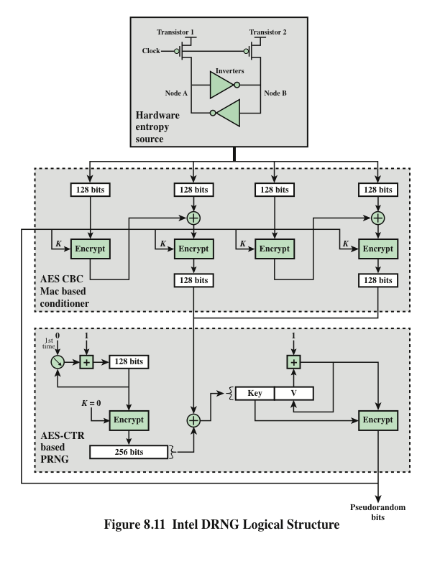
Notes:
Figure 8.11 provides a simplified view of the logical flow of the Intel DRNG. As was described,
the heart of the hardware entropy source is a pair of inverters that feed each other.
Two transistors, driven by the same clock, force the inputs and outputs of both inverters to
the logical 1 state. Because this an unstable state, thermal noise will cause the configuration
to settle randomly into a stable state with either Node A at logical 1 and Node B at
logical 0, or the reverse. Thus the module generates random bits at the clock rate.
The output of the entropy source is collected 512 bits at a time and used to
feed to two CBC hardware implementations using AES encryption. Each implementation
takes two blocks of 128 bits of “plaintext” and encrypts using the CBC
mode. The output of the second encryption is retained. For both CBC modules, an
all-zeros key is used initially. Subsequently, the output of the PRNG stage is fed
back to become the key for the conditioner stage.
The output of the conditioner stage consists of 256 bits. This block is provided
as input to the update function of the PRNG stage. The update function is initialized
with the all-zeros key and the counter value 0. The function is iterated twice to
produce a 256-bit block, which is then XORed with the input from the conditioner
stage. The results are used as the 128-bit key and the 128-bit seed for the generate
function. The generate function produces pseudorandom bits in 128-bit blocks.

Slide 47
Summary
Principles of pseudorandom number generation
  The use of random numbers
  TRNGs, PRNGs, and PRFs
  PRNG requirements
  Algorithm design
Pseudorandom number generators
  Linear congruential generators
  Blum Blum Shub generator
Pseudorandom number generation using a block cipher
  PRNG using block cipher modes of operation
  ANSI X9.17 PRNG
  NIST CTR_DRBG
Stream ciphers
RC4
  Initialization of S
  Stream generation
  Strength of RC4
True random number generators
  Entropy sources
  Comparison of PRNGs and TRNGs
  Conditioning
  Health Testing
  Intel digital random number generator
Notes:
Chapter 8 summary.

